Slide 1
Stress Management

Slide 2

Stress:
Event
Demand
Resources
Discrepancy
Real
Stress
Perceived

Slide 3
Stress is any uncomfortable "emotional experience accompanied by predictable biochemical, physiological and behavioral changes."

Slide 4
Sources of Stress
External
Internal

Slide 5
EXTERNAL STRESSORS
Physical Environment
Social Interaction
Organizational
Major Life Events
Daily Hassles

Slide 6
EXTERNAL STRESSORS
PHYSICAL ENVIRONMENT
Noise
Bright Lights
Heat
Confined Spaces
SOCIAL INTERACTION
Rudeness
Bossiness
Aggressiveness by others
Victim of bullying and teasing

Slide 7
EXTERNAL STRESSORS
ORGANISATIONAL
Rules and regulations
Deadlines
Unhealthy work environment
Workload
Role conflict & role ambiguity
MAJOR LIFE EVENTS
Birth of a new born baby
Death of loved one
Termination from job
Promotion in job
Retirement
Change in marital status

Slide 8
EXTERNAL STRESSORS (cont…)
DAILY HASSLES
Traffic jam
Load shedding
Problem of transportations
Misplaced keys
Mechanical breakdowns

Slide 9
INTERNAL STRESSORS
Lifestyle choices
Negative self - talk
Mind traps
Personality traits

Slide 10
INTERNAL STRESSORS
LIFESTYLE CHOICES
Use of caffeine
Lack of proper sleep
Overloaded schedule
NEGATIVE SELF - TALK
Pessimistic thinking
Self criticism
Over analyzing

Slide 11
INTERNAL STRESSORS
PERSONALITY TRAITS
Perfectionists
Workaholic
Hurry up personality trait
MIND TRAPS
Unrealistic expectations
Taking things personally
All or nothing thinking
Exaggeration
Rigid thinking

Slide 12


Can Stress be Good for You??

Slide 13
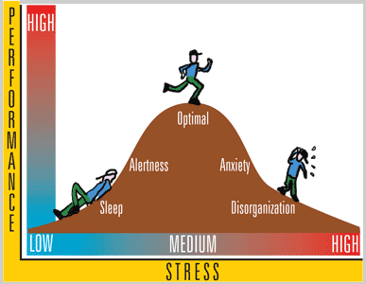
Performance/ ability to cope
Arousal / Demands

Slide 14
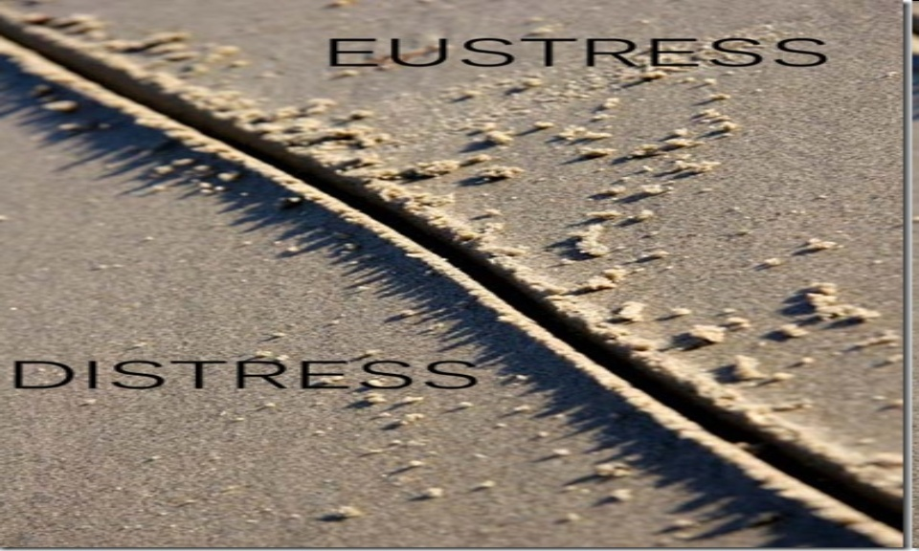
Not every Stress is Bad…

Slide 15
Two Types of Stress
Distress:
Distress or negative stress occurs when your level of stress is either too high or too low and your body and/or mind begin to respond negatively to the stressors. It is the all encompassing sense of being imposed upon by difficulties with no light at the end of the tunnel.
Eustress:
Eustress or positive stress occurs when your level of stress is high enough to motivate you to move into action to get things accomplished. We may feel challenged, but the sources of the stress are opportunities that are meaningful to us.

Slide 16
How Stress Affects???
Cognitive (Negative Thought)
Physiological (Negative Bodily Reaction)
Emotional (Negative Emotion)
Behavioral (Under Achievement)

Slide 17
Cognitive
Mental Filter
Disqualifying the Positive
'All or Nothing' Thinking
Overgeneralization
Jumping to conclusion
Magnifying or Minimizing
Personalization
Should and outs
Labeling

Slide 18
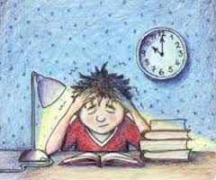
Physiological Symptoms
Sleep pattern changes
Fatigue
Digestion changes
Loss of sexual drive
Headaches
Aches and pains
Breathlessness
Missed heartbeats
Infections
Indigestion
Dizziness
Fainting
Sweating & trembling
Tingling hands & feet
Palpitations

Slide 19
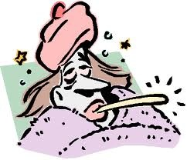
Physiological Symptoms Cont...
Longer term stress symptoms
Backache
Weight loss/gain
Colds, flu etc.
Viral illness
Heart attack
Ulcer

Slide 20
EMOTIONAL SYMPTOMS
Bouts of depression
Impatience
Fits of rage
Tearfulness
Frustration
Disappointment
Rejection
Irritability and restlessness
Failure
Helpless
Fear
Hopeless
Sadness
Guilt
Disgust

Slide 21
BEHAVIORAL SYMPTOMS
Appetite changes - too much or too little
Eating disturbance
Increased intake of alcohol & other drugs
Fidgeting
Nail biting
Hypochondria
Difficulty concentrating
Feeling blank
Loss of efficiency
Focusing on peripheral activities
Explosive outbursts leading to physical attack

Slide 22
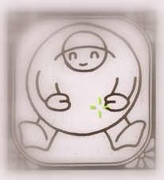
Unhealthy ways of Stress Management
Smoking
Drinking too much
Overeating or undereating
Zoning out for hours in front of TV or Computer
Withdrawing from friends, family and activities

Slide 23
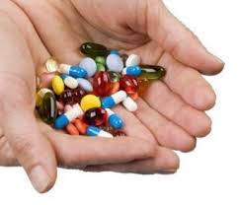
Cont…
Using pills or drugs to relax
Sleeping too much
Procrastination
Filling up every minutie of the day to avoid facing problems
Taking out stress on others (lashing out, angry outburst, physical violence)

Slide 24
How to deal with Stress
Prevention of Stress
Management of Stress

Slide 25
Prevention of Stress
Learning Time Management
Learning Assertiveness
Practicing Coping Strategies
Seeking Social Support
Modeling
Practicing Relaxation

Slide 26
Time Management:
Make a list of What NEEDS to be done
What would you LIKE to do
Cut out time wasting
Learn to drop unimportant activities
Say no or delegate

Slide 27
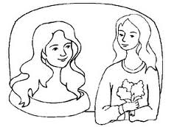
Assertiveness
Being assertive involves standing up for your personal rights and expressing your thoughts, feelings and beliefs directly, honestly and spontaneously in ways that don’t infringe the rights of others.
So, Assertiveness means -
ability to make request
ability to say ‘no’ appropriately
ability to accept ‘no’

Slide 28
Assertiveness
Establish good eye contact , don’t stare
Stand or sit comfortably - don’t fidget
Talk in a firm, steady voice
Use body language
Use “I” language such as: ‘I think’ / ‘I feel’
Concise the sentence
Benefits
Higher self-esteem
Less self-conscious
Less anxious
Manage stress more successfully
Appreciate yourself and others more easily

Slide 29
Coping
Coping is the process by which people try to `manage’ the perceived discrepancy between the demands and resources they appraise in a stressful situation.
Emotion focused Coping: Dealing with an emotion which is bothering you.
Problem focused Coping: Resolving the problem

Slide 30
Seeking Social Support
Social support means having friends and other people, including family, to turn to in times of need or crisis to give you a broader focus and positive self-image.
Social support enhances quality of life and provides a buffer against adverse life events. Those who have close personal relationships cope better with various stressors including bereavement, job loss, rape, and illness (See Salovey, 2000).

Slide 31
Modeling
Observational Learning: We can see and model the actions of people who manage stress very well.
We see what others do and the consequences of the behavior the models perform.

Slide 32

Relaxation
Deep breathing
Progressive Muscle Relaxation: Focusing attention on specific muscle groups while alternately tightening and relaxing these muscles.
Visualization
Meditation

Slide 33
Stress Management
RECOGNIZE THE PROBLEM
The most important point is to recognize the source of the negative stress.
This is not an admission of weakness or inability to cope! It is a way to identify the problem and plan measures to overcome it.

Slide 34
References
Baum, A. (1990). "Stress, Intrusive Imagery, and Chronic Distress," Health Psychology, Vol. 6, pp. 653-675
https://www.scribd.com/doc/19454893/PPT-on-Stress-Management
http://www.takingcharge.csh.umn.edu/explore-healing-practices/social-support
Lifestyle choices• Negative self - talk •Mind traps• Personality traits

Slide 35


Questions

